Slide 1
Car Resale Price Prediction

Slide 3
Start
Data Processing
(ML Models)
Data Collection
Random Forest
XGBoost Regression
AdaBoost Regression
Data Transformation
Best R2 Score Model
Data Cleaning
Pickle File

Slide 4
Dataset
Data extracted from website, Instead of downloading datasets from online sources
Model will be trained on live market value.
Sources: cars24, cardekho

Slide 5
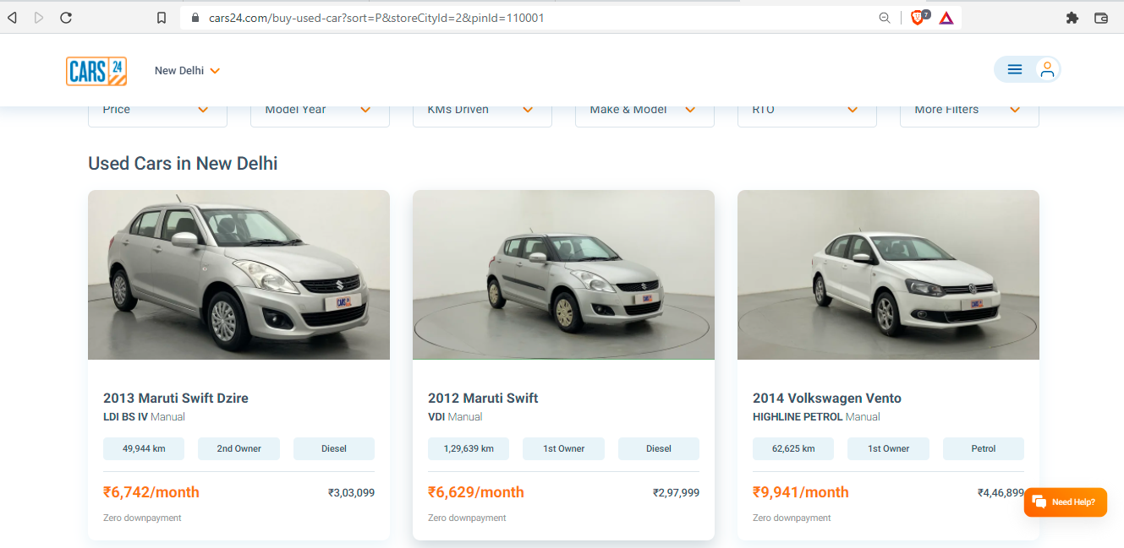

Slide 6
<div class="col-4">
<div class="_1l4fi">
<div class="_15rKe">
<div class="_1jpRU">
<h2 class="_3FpCg">2012 Maruti Swift</h2>
<p class="cvakB">VDI
<span>Manual</span></p></div></div>
<ul class="bVR0c"><li>1,29,639 km</li>
<li>1st Owner</li>
<li>Diesel</li>
</ul><div class="_19zc5"><div class="_2HFRN">
<strong>₹6,629/month</strong></div>
<div class="_7udZZ"><span>₹2,97,999</span></div></div>
<div class="JvSRy">
<span class="_3X7mV _2H07I">Zero downpayment</span></div>
</div></a></div>

Slide 7
Modules Used for Data Extraction
Selenium Python
To get the html data
Html parser
To parse the data and get values needed
Python Pandas
To Store the data in csv file ( Structured format )

Slide 8
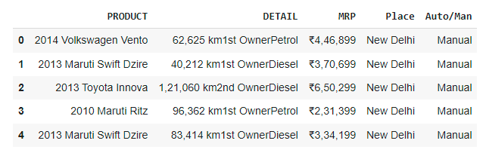
Source
Selenium
HTML Parser
Product
Features
Auto/Man
place
Price

Slide 9
Data Cleaning

Slide 10
User Interface
Front End: KivyMD Python…..why?
Because it is a graphical interface tool which can be implemented both on android as well as desktop.
Back End: Python ( No database )
Because already the model has been deployed, the only thing the backend has to do is the selection of pickle file and predicting the price with the given features

Slide 11
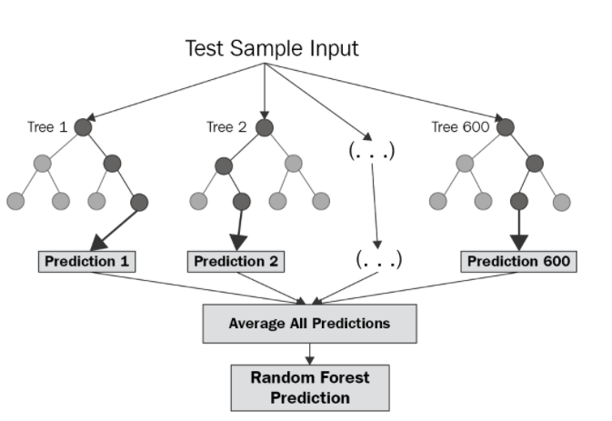
Random Forest

